Slide 1
MAYOR OF LONDON · GREATER LONDON AUTHORITY
London Data Week Hackathon
Using data to identify decarbonisation opportunities
dfl.london.gov.uk

Slide 2
THE PROBLEM
London’s buildings
60%+ of emissions
need 37% cut in domestic heat demand
up to 50% of past retrofit specs were wrong once properly surveyed
Data for London · dfl.london.gov.uk
6
Notes:
We want to solve a data quality and targeting problem, not just a modelling one.

Slide 3
WHAT WE BUILT
RetrofHEAT
We tested our approach on four residential case-study buildings, two in London and two outside
Kent and Ashford
Outside of London
Older housing
Biggest retrofit upside
Tower Hamlets and Barking & Dagenham
Inside of London
Close to London
Similar demographics, but outside of GLA’s data policy remit
Notes:
Kent and Ashford (outside of London) because it’s one of the close towns to London and it’s a good retrofit candidate because they have old houses. 1. Ashford has a substantial proportion of older housing (a mix of Victorian terraces in the town centre and postwar estates): older solid-wall construction is typically the least energy-efficient and most improvable.
2. A genuine out-of-London comparator, not a random one — Ashford is one of the closest towns to London with strong commuter links (roughly 40 minutes by high-speed rail to St Pancras), so it's a fair "edge case" for testing whether a London-trained model generalises: similar commuter demographics and housing pressures to outer London, but built and administered entirely outside the GLA's data and policy remit.

Slide 4
Can we vouch for it?
What the model got right
How we evaluated it
Caveats (areas of weaknesses; what could still go wrong)
skore report highlights
Mayor of London · Greater London Authority
Notes:
Daniel can include: skore report highlights

Slide 5
Can We Vouch For It?
Evaluated with skore — not just trained, tested
Naive model
Corrected model
93% accuracy
looked great...
...but missed 99% of buildings
that actually needed retrofit.
84% accuracy
class-weighted for imbalance
...now catches 64% of buildings
that actually need retrofit.
ROC AUC 0.86 · Precision–Recall used as primary metric (target is imbalanced: ~6% of buildings are non-compliant)
Notes:
This is the single strongest evidence slide. Say plainly: naive accuracy hid a broken model. Fixing it is the vouch-for-it moment.

Slide 6
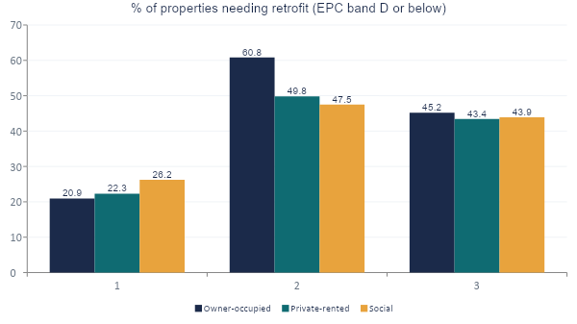
Key Insight: Not a One-Size-Fits-All Answer
We tested the assumption that social housing always has the highest retrofit need. It doesn't.
Tower Hamlets
Social housing has the highest need (26.2%)
Barking & Dagenham
Social housing has the LOWEST need (47.5%) — owner-occupied is highest
Ashford
All tenures cluster within 2 points of each other
Notes:
This is the insight that separates us from a clean-demo team. A national social-housing-first policy would misallocate in Barking & Dagenham specifically.

Slide 7

From Insight to Action
If a council officer used this list tomorrow, here's where they'd start.
Ward | Social housing needing retrofit | Avg IMD decile (1=most deprived)
Alibon | 68.1% | 2.98
Longbridge | 64.7% | 4.59
Becontree | 60.5% | 2.21
What changes tomorrow
3 named wards to survey first — not 32 boroughs to figure out
Retrofit spend targets deprivation and emissions at once
Tenure-blind policy avoided — Barking & Dagenham needs an owner-occupied focus, not social-housing-first
All three wards: Barking and Dagenham — highest deprivation, highest social-housing retrofit need, all in one borough.
Notes:
This is the direct answer to the GLA's own takeaway question. Say it almost verbatim: 'here's what a council officer does differently tomorrow.'

Slide 8

Caveats — Stated Plainly
Ashford is one convenience case, not a systematic sample
A single non-London town given today's time constraints — a real finding, but not yet a representative baseline.
No IMD or fuel-poverty data exists for Ashford
London has this pre-linked at building level (LBSM v2). Most of England outside London doesn't — a genuine national data-infrastructure gap, not our gap.
Ward-level fuel poverty scores are dated (~2009–2010)
We cross-checked against DESNZ's current 2023 borough-level figures where possible, and used both together deliberately.
Notes:
Naming these ourselves, unprompted, is the strongest possible signal that we can be trusted with this data.

Slide 9



Why Residential Prioritisation Matters Here
Scale
Equity
Tractability
Residential buildings are the largest, most tractable share of London's 37% heat-demand-reduction target.
Retrofit targeting by deprivation decile serves decarbonisation and fairness simultaneously — not a trade-off.
Named wards, not abstract borough averages — a council officer can act on this list tomorrow.
Data for London · dfl.london.gov.uk
Notes:
Close on their own three prompts: scale, tractability, and — bridge back — equity. End with confidence, not a trailing caveat.

Slide 10
TAKEAWAYS
How this matters
If a council officer used this list tomorrow, what would they do differently?
Why residential housing prioritisation matters here specifically (scale, tractability)
Why residential housing
Find data from across London quickly and easily, in one place.
Access
Open, transparent city data for services, research and policy.
Share
Legal, ethical and purposeful data sharing across the city.
Data for London · dfl.london.gov.uk
2

